Slide 1
E-business
------The group of IKUN
Notes:
Generate By MotionGo-ChatPPT. Home：motion.yoo-ai.com AIGC 2023/4/26 10:27:49

Slide 2
Introduction of E-business
business历史与演变
Advantages of E-business
The challenge of E-business
business的应用领域
business的战略与技术
Notes:
Generate By MotionGo-ChatPPT. Home：motion.yoo-ai.com AIGC 2023/4/26 10:27:49

Slide 3
01
Introduction of E-business
Overview of Business.
Notes:
Generate By MotionGo-ChatPPT. Home：motion.yoo-ai.com AIGC 2023/4/26 10:27:49

Slide 4
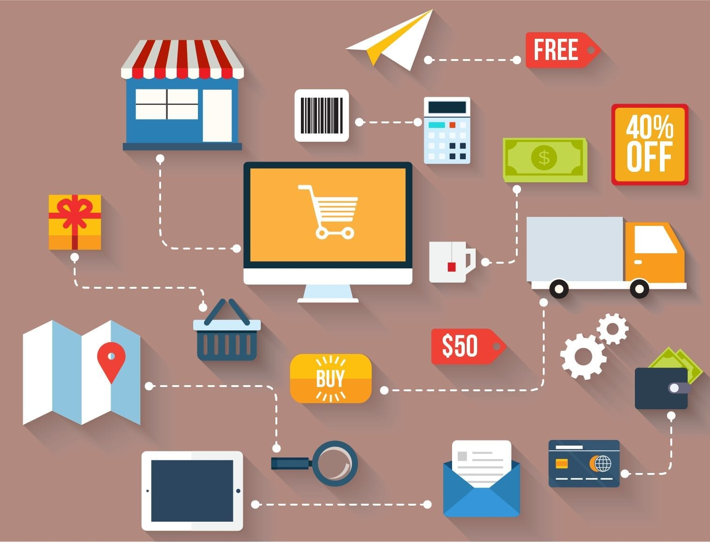
Definition of E-business
E-business, short for Electronic business, refers to the conduct of business activities, processes, and transactions - such as buying and selling goods and services, marketing and advertising, and customer service - over the Internet and other electronic networks.
Notes:
Generate By MotionGo-ChatPPT. Home：motion.yoo-ai.com AIGC 2023/4/26 10:27:49

Slide 5
History of E-business
The development of E-business can be traced back to the 1960s when companies began to use Electronic Data Interchange (EDI) to exchange business documents electronically.
In the 1990s, the Internet revolutionized E-business, making it accessible to a wider audience. The development of online marketplaces and shopping carts enabled businesses to sell products and services online, while digital marketing allowed them to reach customers more effectively.
The early 2000s saw the rise of cloud computing and Software as a Service (SaaS), which provided businesses with practical and cost-effective solutions for managing E-business operations.
Notes:
Generate By MotionGo-ChatPPT. Home：motion.yoo-ai.com AIGC 2023/4/26 10:27:49

Slide 6

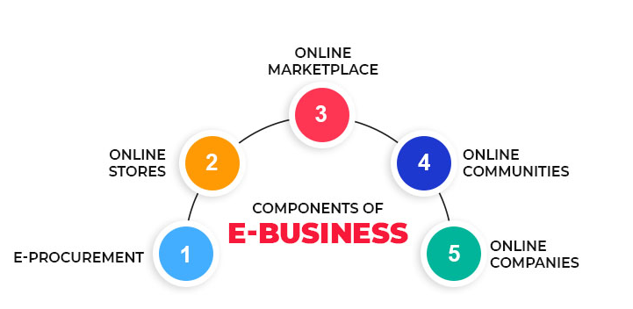
The impact of E-business on business models
E-business has had a significant impact on traditional business models.
One of the key benefits of E-business is the ability to remove geographic barriers, allowing businesses to reach a larger client base. This has led to the emergence of new business models, such as the e-commerce model, which allows businesses to conduct transactions over the internet.
Another significant impact of E-business has been the ability to streamline business processes and enhance supply chain management. Through the use of technology, businesses can automate many of their day-to-day functions, reducing costs and increasing efficiency.
Notes:
Generate By MotionGo-ChatPPT. Home：motion.yoo-ai.com AIGC 2023/4/26 10:27:49

Slide 7
02
business历史与演变
The history and evolution of business.
Notes:
Generate By MotionGo-ChatPPT. Home：motion.yoo-ai.com AIGC 2023/4/26 10:27:49

Slide 8



商业及其历史
电子商务：现状与趋势 商业及其历史：电子商务如何改变商业模式和消费方式？ 随着互联网技术的飞速发展，电子商务迅速崛起。与传统的实体店相比，电子商务具有更低的运营成本、更广泛的市场范围和更便捷的消费体验等优势。电子商务的出现，改变了商业的格局和消费者的生活方式。其中一些主要影响包括： 便捷的购物体验 借助电子商务平台，消费者可以随时随地购买商品。无论是工作日还是周末，上午还是半夜，都可以通过电子设备轻松完成购物。此外，在电子商务平台上，消费者还可以轻松比较不同产品的价格和质量，从而做出更明智的购买决策。 电子商务平台使得商家可以不受地域限制地销售产品，极大扩展了他们的市场范围。网络平台，使得跨境贸易成为可能，为消费者提供了更多高质量、低价的商品。这大大增加了消费者的选择，同时也加快了市场竞争。 随着互联网技术的不断升级，电子商务已经成为在商业市场中的不可或缺的一部分。通过互联网，商家和消费者可以更加紧密地联系，进一步扩大销售和服务范围。同时，电子商务也催生了新的商业模式，如共享经济、小额信贷等等，对商业发展带来了深刻的影响。
Notes:
Generate By MotionGo-ChatPPT. Home：motion.yoo-ai.com AIGC 2023/4/26 10:27:49

Slide 9



电子商务的定义
电子商务是指利用互联网和计算机技术，实现在线购物、在线支付、在线交易、在线客服等商业活动的全部过程。其中，电子商务的核心是在线交易，它完全依赖于互联网技术与电子商务平台的支持。除此之外，电子商务还包括电子商务门户网站、电子商务搜索引擎、电子商务数据统计与分析、电子商务安全等多个方面。
Notes:
Generate By MotionGo-ChatPPT. Home：motion.yoo-ai.com AIGC 2023/4/26 10:27:49

Slide 10
03
E-business的优势
Advantages of E-business.
Notes:
Generate By MotionGo-ChatPPT. Home：motion.yoo-ai.com AIGC 2023/4/26 10:27:49

Slide 11
Advantages of E-business.
Advantage 1: Convenient transaction methods
Advantage 2: Global market coverage
E-business enables customers to make purchases online, anytime and anywhere, without the need to physically visit a store or office. This convenience attracts more customers, especially those who prefer to shop from the comfort of their own homes. Additionally, e-business allows for various payment options such as credit cards, PayPal, or bank transfers, making transactions more flexible and accessible.
E-business transcends geographical boundaries, enabling businesses to reach customers worldwide. This means businesses can tap into new markets and target audiences, increase brand awareness and customer loyalty, and expand their customer base.
Notes:
Generate By MotionGo-ChatPPT. Home：motion.yoo-ai.com AIGC 2023/4/26 10:27:49

Slide 12
Advantages of E-business.
Advantage 3: Lower operating costs
Advantage 4: Increased sales
E-business eliminates the need for physical stores and offices, reducing overhead costs such as rent, utilities, and maintenance. Additionally, e-business enables businesses to automate certain processes, such as inventory management and order processing, reducing the need for manual labor.
E-business provides businesses with the opportunity to reach a wider audience, resulting in increased sales. E-business allows businesses to gather data and insights into customer behavior, which can be used to tailor marketing strategies and promotions to specific audiences, further increasing sales.
Notes:
Generate By MotionGo-ChatPPT. Home：motion.yoo-ai.com AIGC 2023/4/26 10:27:49

Slide 13
04
E-business的挑战
The challenge of E-business.
Notes:
Generate By MotionGo-ChatPPT. Home：motion.yoo-ai.com AIGC 2023/4/26 10:27:49

Slide 14
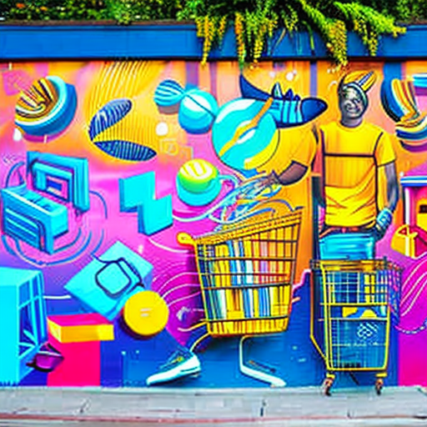
Security issues:
As e-businesses rely more on technology, they also face security threats such as hacking(黑客), phishing(网络钓鱼), and identity theft(身份盗用). To protect sensitive customer data and ensure secure transactions, companies need strong security measures.
Legal and regulatory issues:
E-businesses must follow various laws and regulations related to data protection, consumer protection, and taxation. Failure to comply with these laws can result in legal action, fines, and damage to reputation.
Explore Now
Read More
Notes:
Generate By MotionGo-ChatPPT. Home：motion.yoo-ai.com AIGC 2023/4/26 10:27:49

Slide 15

Intense market competition
It's easy to enter the e-business market, resulting in intense competition. Companies need to continuously innovate(创新) and differentiate themselves to remain competitive and attract and retain customers.
Consumer trust issues
E-businesses rely on customer trust for online transactions. However, incidents of data breaches(数据泄露) and scams(诈骗) have eroded(侵蚀) consumer trust in e-businesses. To overcome this challenge, companies need to establish a strong brand reputation, provide excellent customer service, and implement robust security measures.
Notes:
Generate By MotionGo-ChatPPT. Home：motion.yoo-ai.com AIGC 2023/4/26 10:27:49

Slide 16
05
business的应用领域
Applications of Business.
Notes:
Generate By MotionGo-ChatPPT. Home：motion.yoo-ai.com AIGC 2023/4/26 10:27:49

Slide 17


电子商务概念解析
电子商务（e-business），指利用互联网及相关技术，开展商务活动的过程。电子商务已经成为现代商业运作的重要方式之一，为企业提供了更广阔的市场、更高效的运营和更多元的营销手段。其发展趋势包括社交电商、移动电商、O2O等，正在进一步推动商业模式的革新。同时，也需要注意电子商务所面临的安全和信任等问题。
Notes:
Generate By MotionGo-ChatPPT. Home：motion.yoo-ai.com AIGC 2023/4/26 10:27:49

Slide 18



电子商务的现状和趋势
跨境电商的全面发展和普及，打破了传统经济全球化路上的种种限制，成为发展世界经济的新引擎。当前，跨境电商行业也在不断发展壮大，预计未来几年，全球跨境电商交易额将高速增长。
Notes:
Generate By MotionGo-ChatPPT. Home：motion.yoo-ai.com AIGC 2023/4/26 10:27:49

Slide 19
06
business的战略与技术
Strategy and Technology of Business.
Notes:
Generate By MotionGo-ChatPPT. Home：motion.yoo-ai.com AIGC 2023/4/26 10:27:49

Slide 20
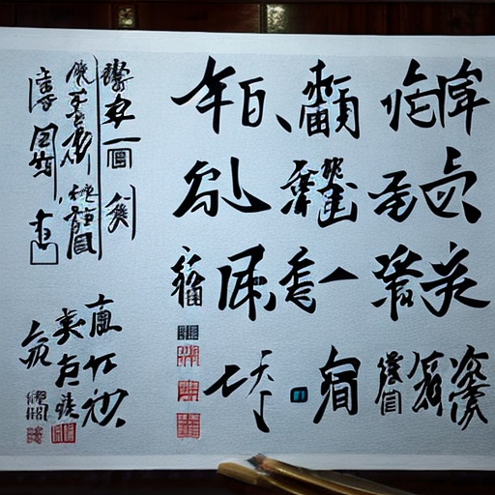
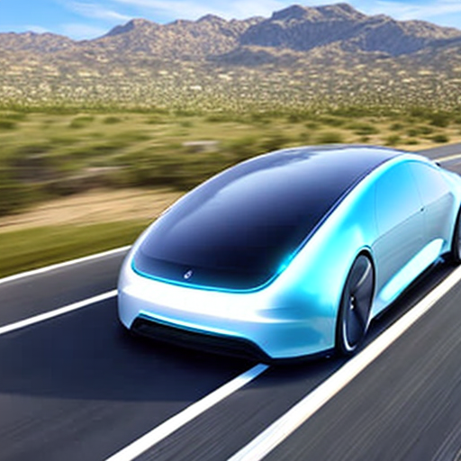

电子商务与市场战略
电子商务是现代商业发展的重要趋势之一，与市场战略密切相关。以下是两个关于《》的内容说明： 1. 新兴技术对市场战略的影响：随着人工智能、大数据等新兴技术的不断发展，电子商务的市场战略将会受到影响。例如，基于大数据分析的精准营销模式能够准确预测消费者需求，帮助电商平台及品牌商定制更加精准的营销策略。因此，电子商务企业需要不断探索新技术的应用，从而掌握新的市场战略。 2. 线上线下融合的市场战略：传统实体企业通过跨界电商、开发APP等方式进行线上扩展，而纯电商企业则开始向线下城市店铺布局。这样的趋势表明，线上线下融合的市场战略已成为电子商务发展的新趋势。而成功的融合模式需要重视线上线下数据的整合，建立更加精细化的客户关系管理体系，提升用户体验。
Notes:
Generate By MotionGo-ChatPPT. Home：motion.yoo-ai.com AIGC 2023/4/26 10:27:49

Slide 21
电子商务平台搭建
1. 技术选型：选择适合自己电子商务平台的技术，如Web开发技术、前端技术、移动端技术和数据库技术，根据自己的需求和特点进行选择和使用。 2. 系统架构设计：电子商务平台的架构设计是非常重要的，需要考虑前端页面设计、后台管理系统设计、数据结构设计、安全性设计等因素，使系统具备可扩展性、可维护性、安全性和高性能等特点。
Notes:
Generate By MotionGo-ChatPPT. Home：motion.yoo-ai.com AIGC 2023/4/26 10:27:49

Slide 22
THANKS
Notes:
Generate By MotionGo-ChatPPT. Home：motion.yoo-ai.com AIGC 2023/4/26 10:27:49

